Slide 1
ASWITHA B
Final Project

Slide 2
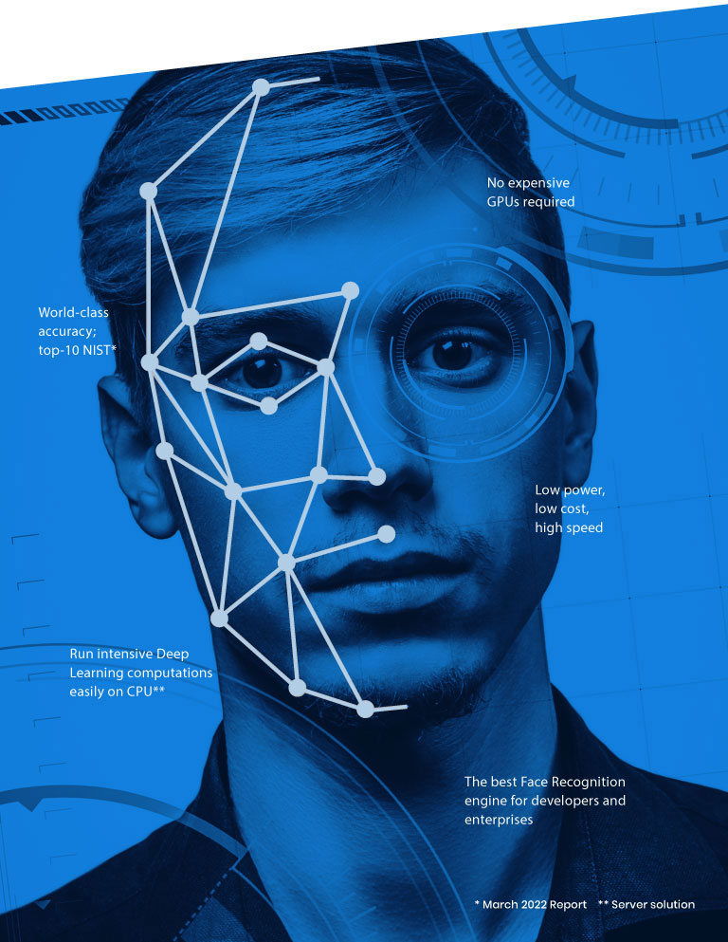
make face filters using face detection
PROJECT TITLE
Make Face Filters Using Face Detection

Slide 3
Dependencies: Import necessary libraries (e.g., OpenCV).
Face Detection Model: Choose and load a pre-trained face detection model.
Filter Image: Prepare the filter image with transparency.
Image Input: Capture from camera or load from disk.
Face Detection: Apply the model to detect faces.
Apply Filter: Resize and position the filter on detected faces.
Blend with Image: Overlay the filter with proper transparency.
Display or Save: Show or save the final result.
Optimize: Fine-tune parameters for better results.
AGENDA
v
v

Slide 4
PROBLEM STATEMENT
Detect the face and a Face filters have become increasingly popular in social media applications, allowing users to add fun and creative effects to their photos and videos. These filters often involve detecting faces in images or videos and applying various graphical overlays or modifications to them.
v

Slide 5
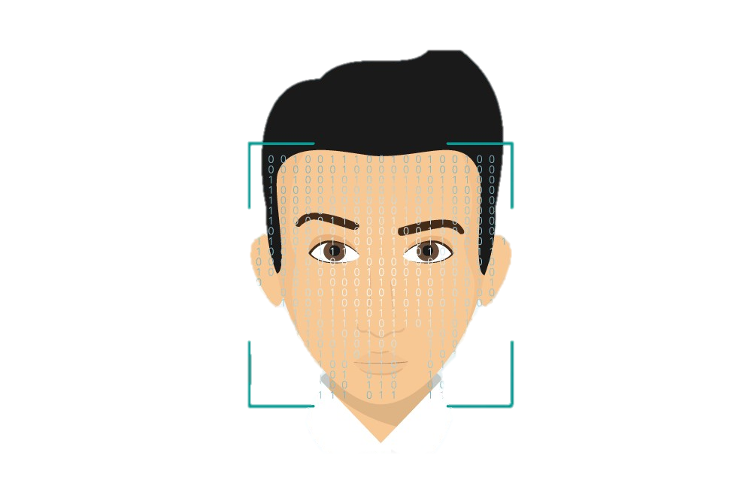
PROJECT
OVERVIEW
Face Detection: Utilize the Haar Cascade classifier for face detection to locate faces within input images.
Filter Application: Implement functions to apply blur and sharpening filters to the detected faces.
Image Processing: Process a set of input images, detect faces, and apply the specified filters to the detected faces.
Visualization: Visualize the input images with bounding boxes around detected faces, along with the images with applied filters.

Slide 6
WHO ARE THE END USERS?
Social media users for tagging friends and applying filters.
Researchers and developers for advancing computer vision algorithms and applications.
Photography enthusiasts use face detection to automate photo organization.
Security personnel for surveillance and identification.
Education sector for attendance management and engagement monitoring.
Healthcare professionals for medical imaging and diagnosis.

Slide 7
SOLUTION AND ITS VALUE PROPOSITION
FACE DETECTION:
Utilizes the Haar Cascade classifier for face detection.
Detects faces in images using detectMultiScale().
IMAGE PROCESSING FUNCTIONS:
BlurFilter (apply_blur()):
Converts the image to grayscale.
Detects faces and applies Gaussian blur to the detected faces.
Sharpening Filter (apply_sharpening()):
Applies a predefined sharpening kernel to the original image.
PROCESSING IMAGES:
Reads images using OpenCV.
Detects faces and draws rectangles around them.
Plots input images with bounding boxes around detected faces.
Applies sharpening and blur filters separately to each image and plots the results.

Slide 8
Deliverables:
Python code implementing the face filter application.
Visualizations showing input images with detected faces and images with applied filters.
Optionally, a report documenting the implementation details and results.
Expected Challenges:
Fine-tuning filter parameters for optimal results.
Handling variations in lighting conditions and facial expressions.
Ensuring efficient processing for real-time applications.
Deliverables:
Python code implementing the face filter application.
Visualizations showing input images with detected faces and images with applied filters.
Optionally, a report documenting the implementation details and results.
Expected Challenges:
Fine-tuning filter parameters for optimal results.
Handling variations in lighting conditions and facial expressions.
Ensuring efficient processing for real-time applications.

Slide 9
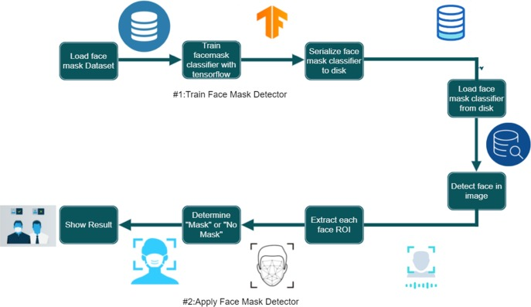
MODELLING
Processing Images:
Reads input images using OpenCV.
Detects faces in the images using the Haar Cascade classifier.
Draws rectangles around the detected faces on the input images.
Applies the sharpening filter and blur filter separately to the detected faces.
Visualizes the input images with bounding boxes around detected faces, along with the images with applied filters.

Slide 10
RESULTS
The provided code conducts face detection and applies image processing filters (blur and sharpening) to the detected faces in input images. The results are displayed using Matplotlib.
Here are the results achieved by the code:
Input images are displayed with bounding boxes around the detected faces.
Separate plots show the input images with applied sharpening filters and blur filters, respectively.
This allows for a visual comparison between the original images and the processed images with applied filters.

Slide 11
THANK YOU

